Slide 1
REPLICATION STUDY
Glucocorticoid-Responsive Genes Modulating Cytokine Function in Airway Smooth Muscle Cells
A Comparison of Modern and the Original RNA-seq Pipelines
Ilia Gogotchuri
Original Paper by Himes BE, Jiang X (2014)
“RNA-Seq Transcriptome Profiling Identifies CRISPLD2 as a Glucocorticoid Responsive Gene that Modulates Cytokine Function in Airway Smooth Muscle Cells”. PLOS ONE 9(6): e99625.
https://doi.org/10.1371/journal.pone.0099625 [1]

Slide 2
Study Background
Original Study (2014)
Dataset Composition
•
Dataset: GSE52778 RNA-seq data from human airway smooth muscle (ASM) cells
8
4
•
Treatment: Dexamethasone (potent glucocorticoid), 12 hours
Total Samples
Donors
•
Pipeline: Tuxedo tools - TopHat2 → Cufflinks → Cuffdiff
•
Reference: hg19 genome
2
12h
Conditions
Treatment
Key Finding
316 significantly differentially expressed genes (p < 0.05) identified. CRISPLD2 discovered as a novel glucocorticoid-responsive gene modulating cytokine function.
Motivation for Replication
RNA-seq analysis pipelines have evolved significantly since 2014, with major improvements in alignment algorithms, quantification methods, and statistical analysis tools. This study evaluates whether modern tooling affects biological conclusions.

Slide 3
Pipeline Evolution
Original Pipeline (2014)
Modern Pipeline
1
TopHat2
1
STAR
Splice-aware alignment to reference genome
~180× faster than competitors; superior splice junction detection [2][3] - uncompressed suffix arrays, MMP, RAM
2
Cufflinks
2
featureCounts
Transcript assembly and quantification
Order of magnitude faster than HTSeq for read assignment [4]
3
Cuffdiff
DESeq2
Differential expression analysis
FPKM value based (fragments per kilobase of transcript per million mapped reads)
3
Negative binomial model with Bayesian shrinkage and count-based approach [5]
Reference: hg19
Reference: hg19 & hg38

Slide 4
Study Design & Objectives
Two-Part Analysis Design
Expected Insights
P1
Part 1: Pipeline Effect
1
Part 1 vs Original: Effect of updated pipeline alone
hg19 + STAR/featureCounts/DESeq2
Part 2 vs Part 1: Effect of updated genome assembly
2
Purpose: Isolate the effect of updated pipeline while keeping reference genome constant
3
Part 2 vs Original: Combined modernization effect
P2
Part 2: Full Modernization
hg38 + STAR/featureCounts/DESeq2
Validation Goal
Purpose: Evaluate combined effect of updated pipeline and reference genome
Compare modern pipeline findings against the original 316 DEGs to assess biological reproducibility and robustness.
O
Original Study
hg19 + TopHat2/Cufflinks/Cuffdiff
Dataset
Baseline: 2014 analysis for comparison
GSE52778: 8 samples (4 donors × 2 conditions)
Untreated vs. Dexamethasone-treated (12h)

Slide 5
Alignment Quality Metrics
Mapping Rate Improvement
Read Count Statistics
Original (TopHat2/hg19)
83.36%
Metric | Original | Modern
Reads (avg) | 58.9M | 48.9M
Reads (min) | 44.2M | 33.7M
Reads (max) | 71.3M | 68.6M
Modern (STAR/hg19)
97.59%
Modern (STAR/hg38)
97.64%
Lower counts due to how reads are processed in TopHat and Star + Splice Junctions
+14.2 percentage point increase
Junction-Spanning Reads
Key Insight
26.4%
45.6%
44.5%
STAR's superior splice site detection algorithm significantly improves both overall mapping rate and junction-spanning capability, enabling more accurate transcript quantification down the line.
Original
Modern on hg19
Modern on hg38
+19.1 percentage point improvement

Slide 6
Differential Expression Summary
Original
Modern (hg19)
Modern (hg38)
TopHat/Cuffdiff/hg19
STAR/DESeq2/hg19
STAR/DESeq2/hg38
316
872
909
DEGs (Q < 0.05)
Significant DEGs
Significant DEGs
Q < 0.05, |LFC| > 1
Q < 0.05, |LFC| > 1
20,561
2,648
2,735
Genes Tested
DEGs (Q < 0.05)
DEGs (Q < 0.05)
99
219
396
476
420
489
Upregulated
Downregulated
Upregulated
Downregulated
Upregulated
Downregulated
2.9×
Predominantly Downregulated
Increase in significant DEGs
Consistent with the original glucocorticoid response

Slide 7
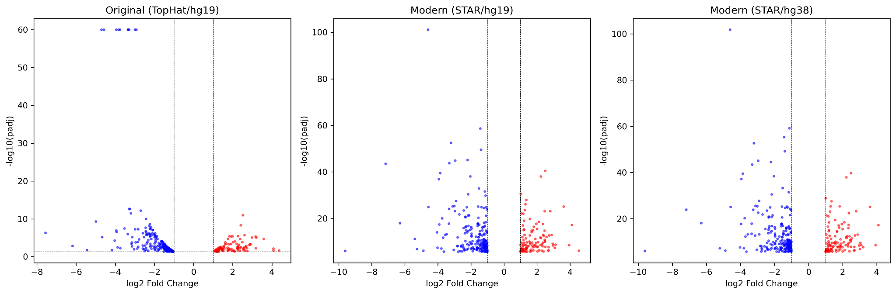
Figure: Volcano plots showing distribution of gene expression changes. Red = upregulated, Blue = downregulated. Modern pipelines show higher sensitivity with more significant hits.
Top 316 hits for consistent comparison.

Slide 8
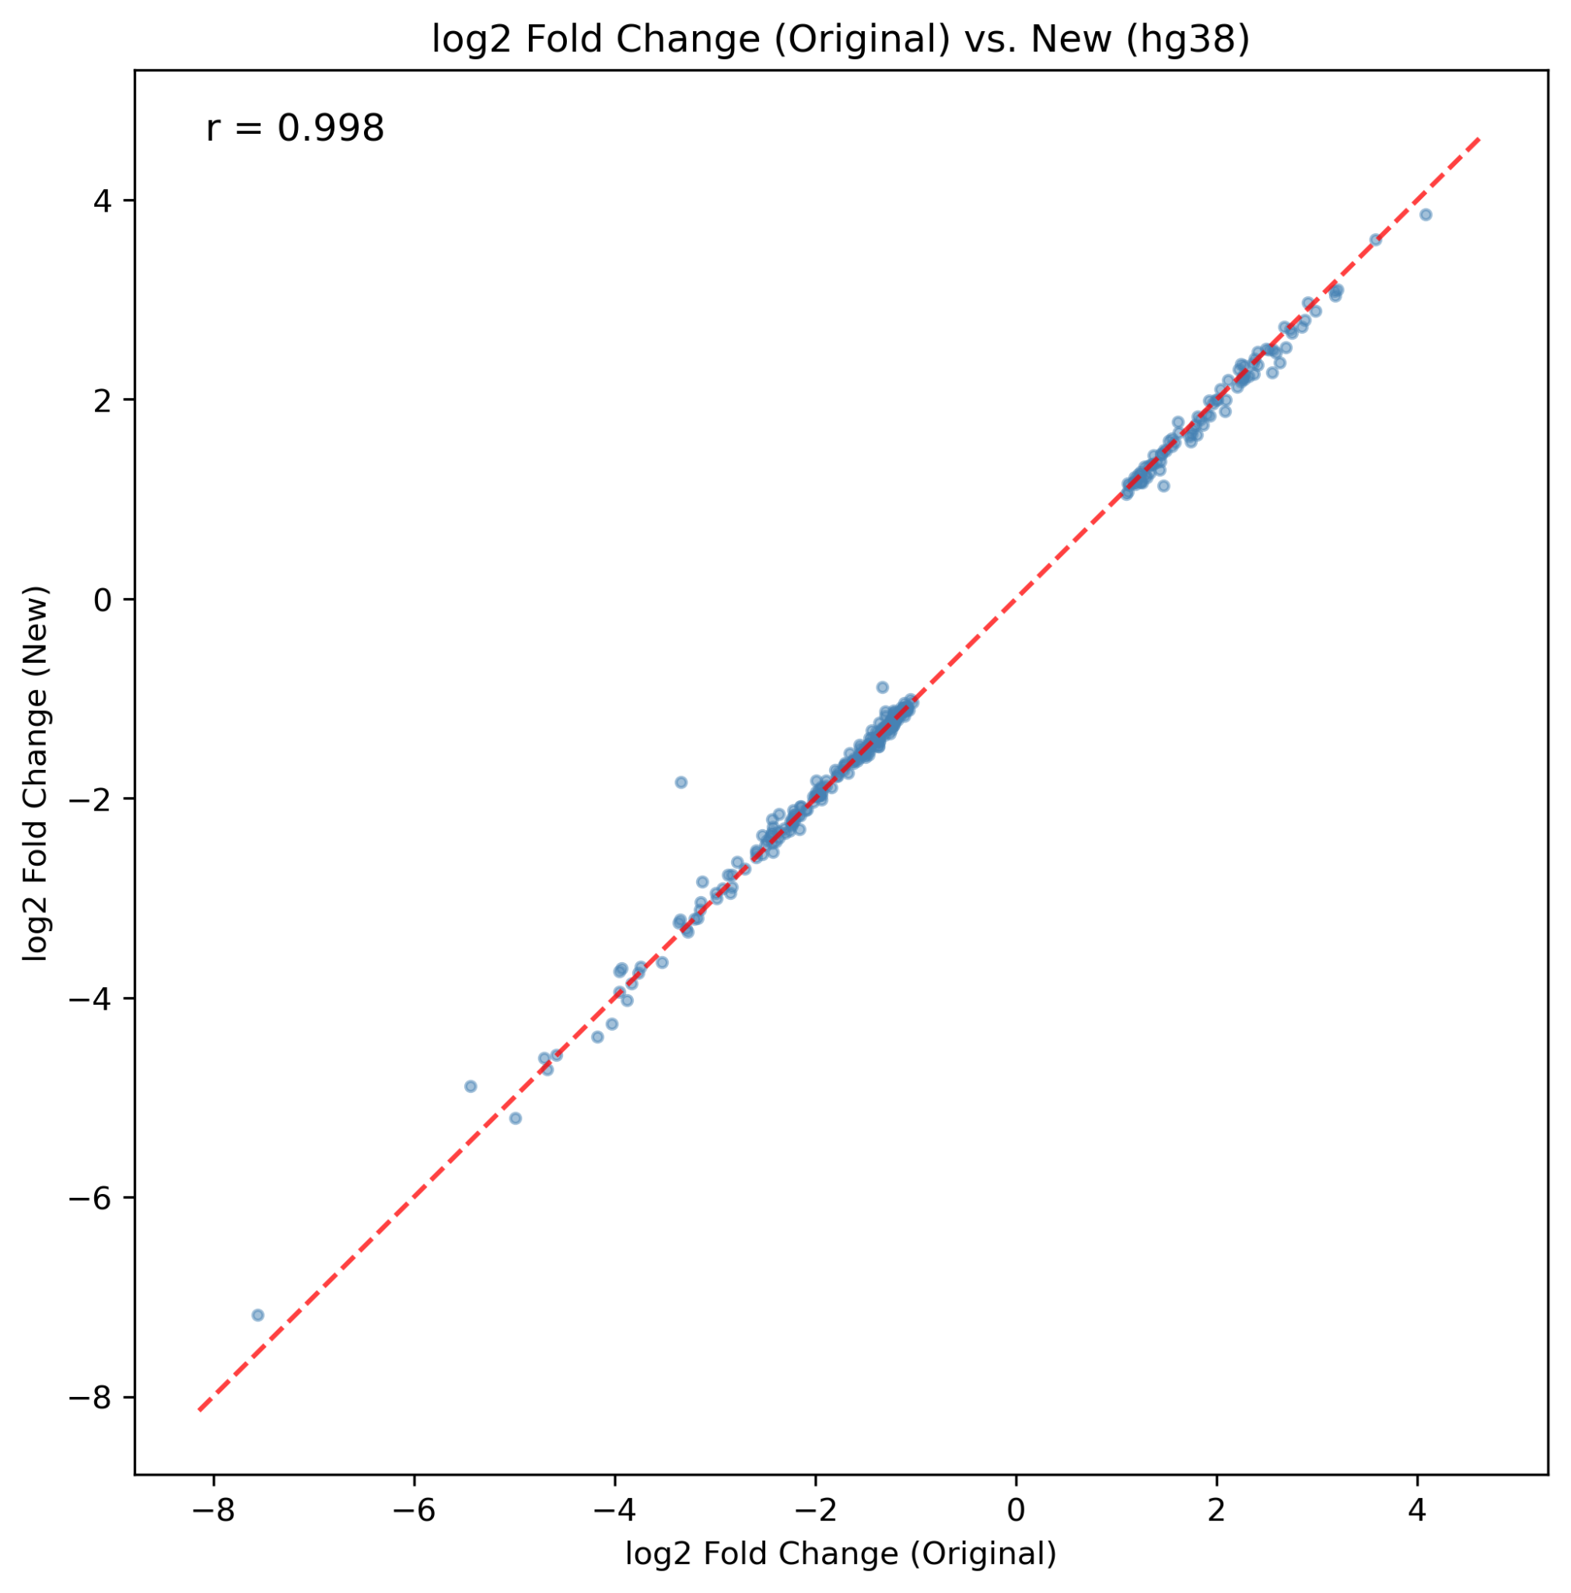
Validation & Correlation Analysis
Gene Rediscovery Rate
log₂ Fold Change Correlation
Modern (hg19)
96.2%
Original vs. Modern (hg19)
304/316
Modern (hg38)
92.4%
292/316
Pearson Correlation
r = 0.998
Between log₂ fold changes
Both genome versions
Validation Rate Drop (hg38)
Primarily due to gene symbol changes, annotation updates, or coordinate shifts between genome builds — likely nota loss of biological signal. I have manual identified 7 DEG symbol changes..

Slide 9
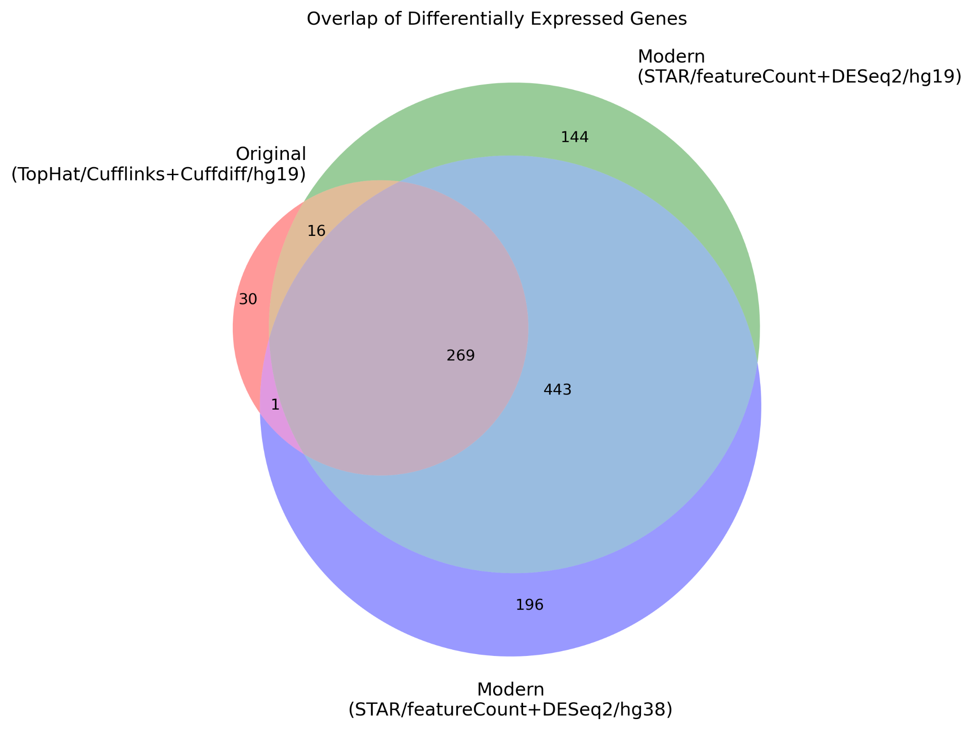
DEG Overlap Analysis
Figure (Venn Diagram):
(O) Original – 316
(M1) hg19 + modern – 872
(M2) hg38 + modern – 909
* Only significant DEGs plotted
Notes
SERPINA3
Validated in hg38 but not hg19 — stronger signal with updated genome (Not sure what happened here)
* Gene Symbol Changes
Gene symbols changed between hg19 and hg38
Overlap Breakdown
(O∩M1) \ M2:
16*
M2 \ M1:
197*
M1 ∩ M2:
443

Slide 10
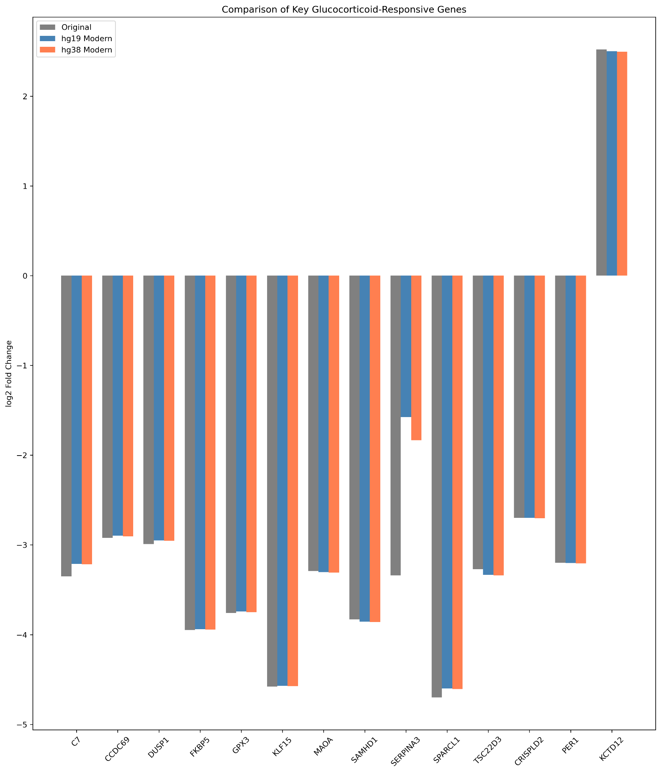
Key Glucocorticoid-Responsive Genes - Validation
Comparison of log₂ Fold Changes
Top DEGs from Original Study
All with padj ≈ 0 (Q < 1×10⁻¹⁶)
KLF15
-4.58
SPARCL1
-4.70
FKBP5
-3.95
SAMHD1
-3.83
GPX3
-3.76
C7
-3.35
SERPINA3
-3.34
MAOA
-3.29
CCDC69
-2.92
DUSP1
-2.99
CRISPLD2 Discovery
Novel finding from original study — glucocorticoid-responsive gene modulating cytokine function in ASM cells.
-2.70
Validated in all three analyses with consistent fold change
log₂FC
Consistency Check
Directions and magnitudes of changes are identical across Original, Modern hg19, and Modern hg38 analyses.
Fold changes are nearly identical across all three analyses

Slide 11
Novel Findings (hg38)
10 Novel High-Confidence DEGs
10
Not reported in original paper • padj < 1×10⁻¹⁰ • |log₂FC| > 1
Novel Genes
Gene | padj (Q value) | log₂FC
GASK1B (FAM198B) | 6.87 × 10⁻⁶⁰ | -1.12
RAB7B | 4.66 × 10⁻²⁶ | 1.83
ENSG00000250978 | 8.37 × 10⁻¹⁹ | -6.30
MARCHF10 | 1.87 × 10⁻¹⁸ | -3.96
LINC02884 | 2.10 × 10⁻¹³ | -3.13
RELL1 | 1.52 × 10⁻¹¹ | -1.12
HMGA2-AS1 | 3.61 × 10⁻¹¹ | -2.35
PEAK1 | 8.70 × 10⁻¹¹ | -1.00
MIR99AHG | 2.45 × 10⁻¹⁰ | 1.51
AOPEP | 8.45 × 10⁻¹⁰ | -1.10
Research Opportunity
Statistical Confidence
Many novel findings (especially ENSG00000250978 and MARCHF10) are not well-studied in context of glucocorticoid response
Very low Q values make these findings statistically unlikely to be false positives. Strong response to dexamethasone treatment detected.

Slide 12
Discussion: Pipeline Modernization
Technical Improvements
Biological Consistency
+14%
Mapping Rate
96.2%
Gene rediscovery rate with modern pipeline
points
83.4% → 97.6%
Rediscovery
+19%
0.998
Near-perfect fold change correlation
Junction-Spanning
Pearson r
points
26% → 45%
Indicates transcriptomic response in ASM to dexamethasone is reproducible and robust to methodological variation.
Mechanism: STAR's splice site detection algorithm works better to map RNA-seq reads and detect splice sites more accurately.
Increased Sensitivity
Specificity Likely Maintained
High correlation suggests increased DEGs reflect true biological signal, not false positives. Original study produced robust findings that withstand pipeline variations.
316
909
Significant DEGs (~3× increase)
Reflects improved alignment rates and more sensitive negative binomial analysis model with Bayesian shrinkage in DESeq2.
Key Glucocorticoid Genes
FKBP5, KLF15, TSC22D3, and CRISPLD2 all validated with near-perfect correlation across analyses.

Slide 13
Discussion: Reference Genome Effects
Minimal Impact on Core Findings
SERPINA3 Case
Comparison between hg19 and hg38 revealed minimal impact on differential expression results. Core biological signals remain consistent. Differences can largely be attributed to symbol and naming alterations.
Validated in hg38 but not in hg19
Also discovered with hg19, but signal was not as strong
Why newer reference allowed detection remains open question
97.59%
97.64%
hg19
hg38
Validation Rate Change
96.2%
92.4%
Novel Gene Discovery
hg19
hg38
Drop likely reflects gene symbol changes, annotation updates, or coordinate shifts — not biological signal loss.
10
Novel high-confidence DEGs
Recommendation
May represent improved annotations in GRCh38 or sequence corrections enabling more accurate read mapping.
Direct gene-level comparisons across genome versions may require additional symbol mapping and annotation reconciliation.

Slide 14
Conclusion
Key Findings
Summary Metrics
1
Validated 96.2% of DEGs with near-perfect fold change correlation (r = 0.998)
96.2%
0.998
Validation Rate
Correlation
2
Modern tools: alignment rates 83% → 97.6%, junction detection nearly doubled
+17%
2.9×
3
Increased sensitivity: 909 vs 316 DEGs (~3×) while maintaining high specificity
Mapping Rate
DEG Increase
4
Genome update (hg19→hg38): minimal impact, but 10 novel genes discovered
Pipeline Comparison
Original
316
Implications
TopHat2/Cuffdiff
DEGs
Original well-designed RNA-seq analysis was robust to pipeline variations
Modern (With even more confidence)
909
STAR/DESeq2
DEGs
Modern tooling provides technical improvements and increased sensitivity
Original biological findings remain valid and reproducible
Original study findings withstand methodological variations

Slide 15
References
1
Himes BE, Jiang X, Wagner P, Hu R, Wang Q, et al. (2014) RNA-Seq Transcriptome Profiling Identifies CRISPLD2 as a Glucocorticoid Responsive Gene that Modulates Cytokine Function in Airway Smooth Muscle Cells. PLOS ONE 9(6): e99625
https://doi.org/10.1371/journal.pone.0099625
2
Dobin A, Davis CA, Schlesinger F, et al. STAR: ultrafast universal RNA-seq aligner. Bioinformatics. 2013;29(1):15-21
doi:10.1093/bioinformatics/bts635
3
Engström P, Steijger T, Sipos B, et al. Systematic evaluation of spliced alignment programs for RNA-seq data. Nat Methods 10, 1185–1191 (2013)
https://doi.org/10.1038/nmeth.2722
4
Liao Y, Smyth GK, Shi W. featureCounts: an efficient general purpose program for assigning sequence reads to genomic features. Bioinformatics 30, 923–930 (2014)
https://doi.org/10.1093/bioinformatics/btt656
5
Love MI, Huber W, Anders S. Moderated estimation of fold change and dispersion for RNA-seq data with DESeq2. Genome biology, 15(12), 550 (2014)
https://doi.org/10.1186/s13059-014-0550-8
Thank you for your attention
Questions?

